Slide 1
Cloud Computing

Slide 2
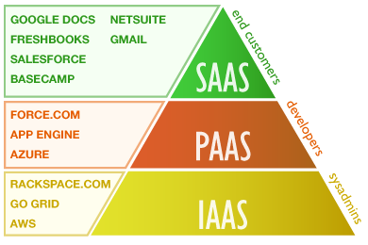
Types of Cloud Services
IaaS - Infrastructure as a service
PaaS - Platform as a service
SaaS - Software as a service

Slide 3
Infrastructure as a service (IaaS)
In an IaaS model, a cloud provider hosts the infrastructure components normally present in an on-premises data center, including servers, storage and networking hardware, as well as the virtualization or hypervisor layer.
The IaaS provider also supplies a range of services to accompany those infrastructure components such as detailed billing, monitoring, log access, security, load balancing and clustering, as well as storage resiliency, such as backup, replication and recovery.

Slide 4
Infrastructure as a service (IaaS)
Advantages:
Operation Flexibility: It provides more flexibility to work because employees can access their files and data offsite and connect to virtual office easily and quickly.
Cost Efficient: IaaS customers pay on a per use basis, typically by the hour, week or month. The pay-as-you-go model eliminates the capital expense of deploying in-house hardware and software.
Up-to-date Technology: IaaS platforms use up-to-date technology that can easily scale up or down to meet business needs. And, because the infrastructure is managed by a third-party service, you will be able to depend on experts to keep your system working.

Slide 5

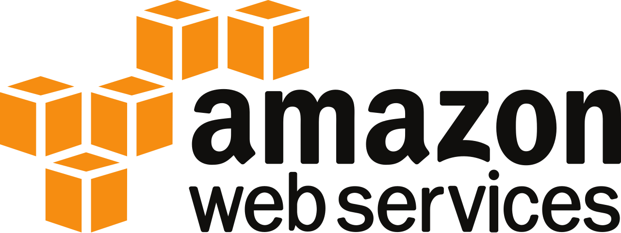
Infrastructure as a Service (IaaS)
Example: [Public Clouds] Amazon Web Services | Microsoft Azure

Slide 6
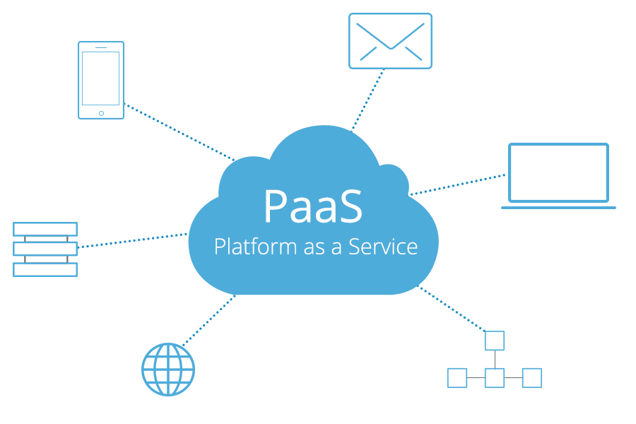
Platform as a Service (PaaS)
Development framework
The framework that developers can build upon to develop or customize cloud-based applications.
Analytics or business intelligence
PaaS allow organizations to analyze and mine their data, finding insights and patterns and predicting outcomes to improve forecasting, product design decisions, investment returns, and other business decisions.
Additional Enhancements of PaaS
Workflow
Directory
Security
Scheduling
Notes:
PaaS includes cloud features such as scalability, high-availability, and multi-tenant capability, and reduces the amount of coding that developers must write.
Tools provided as a service with PaaS allow organizations to analyze and mine their data, finding insights and patterns and predicting outcomes to improve forecasting, product design decisions, investment returns, and other business decisions.
In addition, PaaS also provides other services that can enhance application’s workflow, directory, security, and scheduling.

Slide 7
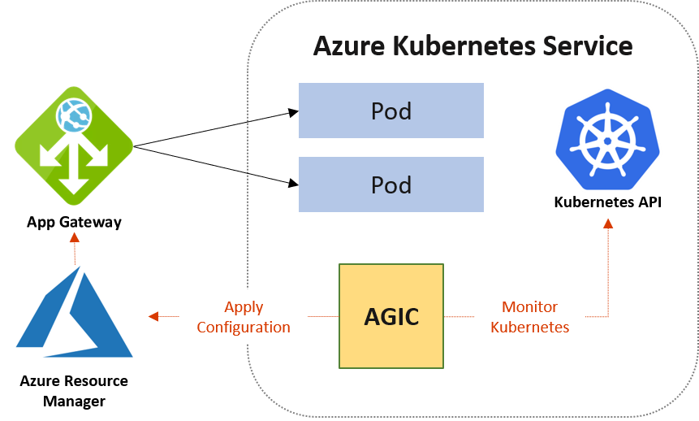
PaaS Example
Employing DevOps practices in Kubernetes environments allows you to move quickly at scale with enhanced security
Notes:
An example of PaaS is Kubernetes and how it employs DevOps practices that allow you to move quickly at scale with enhanced security
----
The Application Gateway Ingress Controller (AGIC) is a Kubernetes application, which makes it possible for Azure Kubernetes Service (AKS) customers to leverage Azure's native Application Gateway L7 load-balancer to expose cloud software to the Internet.
---
The Ingress Controller runs in its own pod on the customer’s AKS. AGIC monitors a subset of Kubernetes Resources for changes. The state of the AKS cluster is translated to Application Gateway specific configuration and applied to the Azure Resource Manager (ARM).

Slide 8
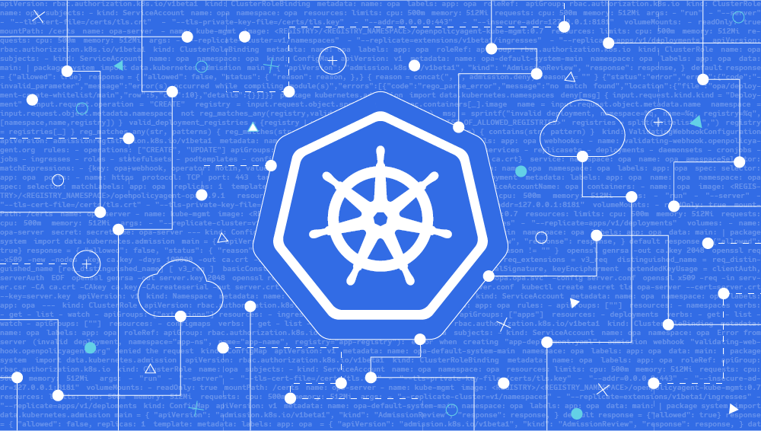
Why PaaS for Kubernetes?
Platform as a Service is a popular choice for businesses who want to create unique applications without spending a fortune or taking on all the responsibility.
Public cloud
A Platform as a Service solution provides the platform for anybody to create unique, customizable software.
Notes:
----
Kubernetes allows for enhanced security and scalability.
So having a platform for users to develop, run, and manage applications without the concerns of having to build and maintain infrastructure is essential.
---

Slide 9
SaaS : Software as a Service
SaaS, also known as cloud computing services, are platforms that make software available to users over the internet, usually for a monthly subscription fee. It is the most utilized option for businesses in the cloud market. The entire service is managed by a third party vendor, making it nice and easy to use without having to worry about maintenance or updates.
Benefits
No need to install and run software applications on your computer
Entire service is a available through the internet, usually accessed when you login
You know exact cost and can budget accordingly, without worrying about hidden surprises.
Reduces the time and money spent on tedious tasks such as installing, managing, and upgrading software

Slide 10
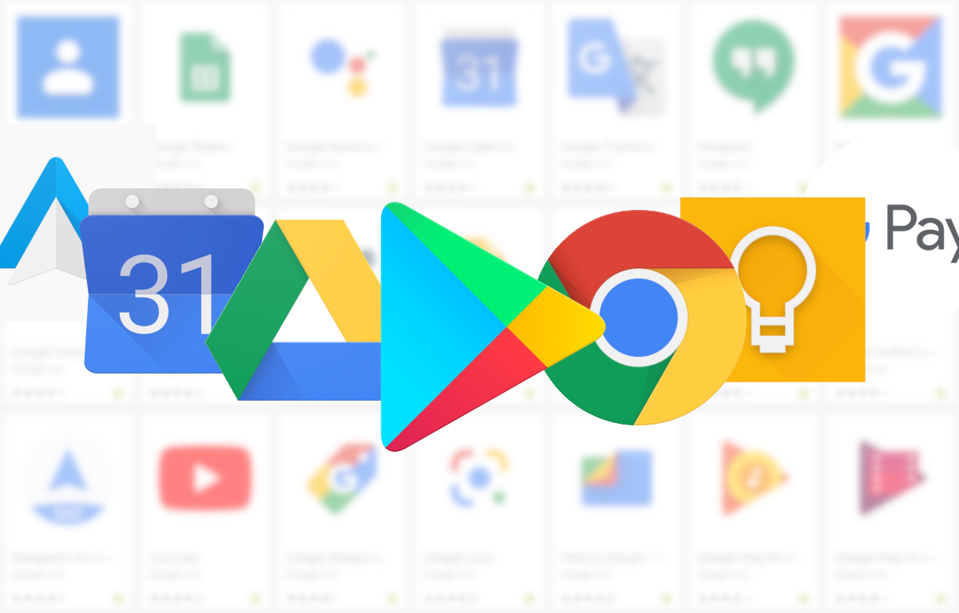
Google Apps : G Suite (Public Cloud)
G Suite is a suite of cloud computing, productivity and collaboration tools, software and products developed by Google.
Allows team to easily work on various projects collaboratively without needing to share the projects among each other locally or having to download and install the software to work on the project.
SaaS that is great for personal and business use.
Interacting with fellows and sharing feedback and progress on a specific task with team members is extremely easy with G Suite.

